Slide 1

HNDIT2417
Mobile Application Development
Introduction to Mobile Computing

Slide 2
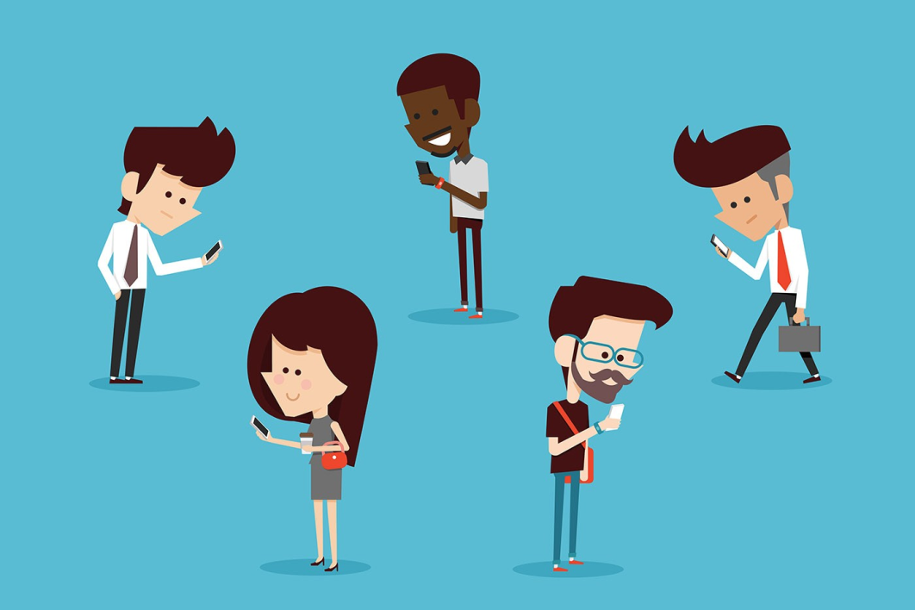
Mobile Computing
Set of technologies which allow people to access data and information from wherever they are

Slide 3
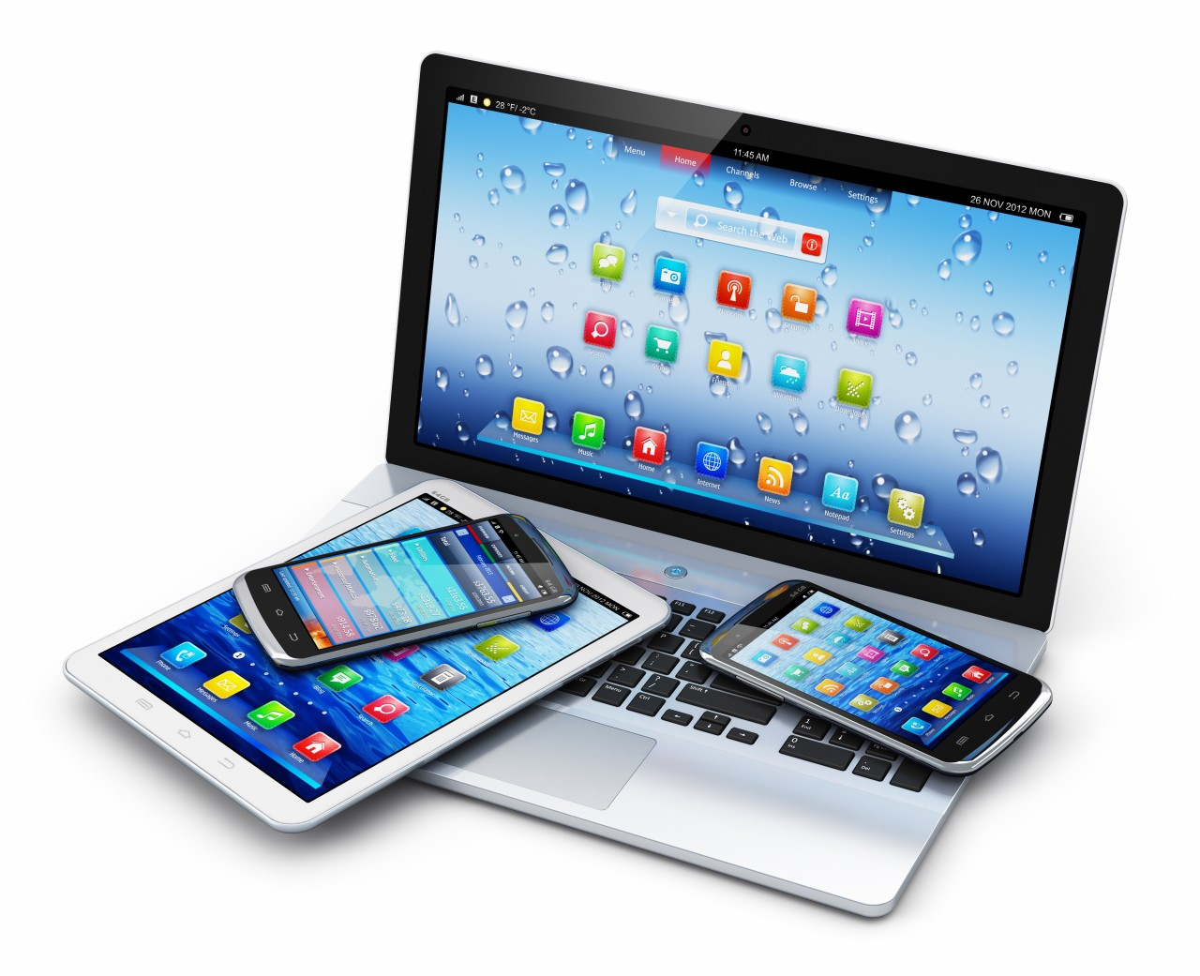
Mobile Devices
A portable computing device such as a smartphone or tablet computer

Slide 4
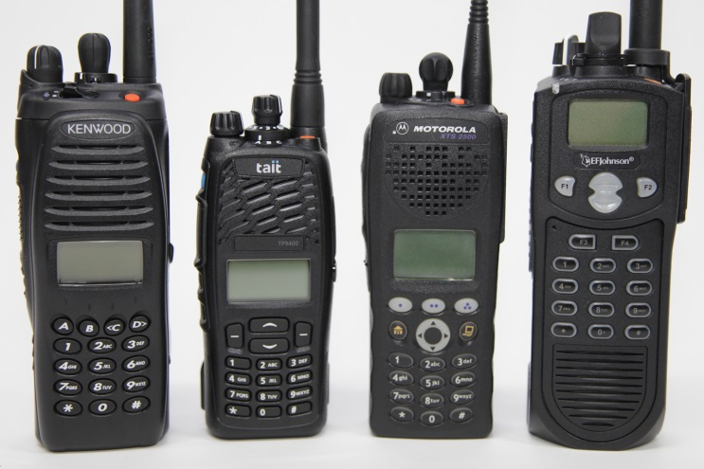
History of Development
Two-way radio (1900) walkie-talkie
  two-way telegraphy traffic across the Atlantic Ocean (1907)
  commercial and military ships carried both transmitters and receivers (1912)
  Victorian Police, Australia (1923)

Slide 5
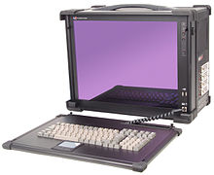
History of Development
The portable computer (1975)
  Computer that is designed to be moved from one place to another and includes a display and keyboard
  Military purposes

Slide 6
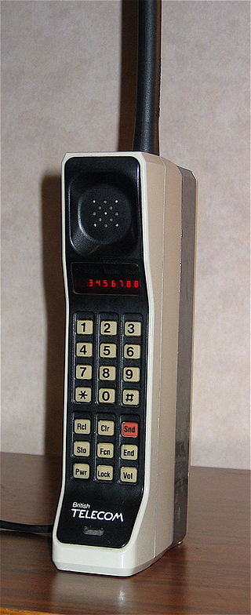
History of Development
Mobile Phone
  Demonstrated by John F. Mitchell and Martin Cooper of Motorola in 1973
  First commercial cellular network (1G) analog was launched in Japan by Nippon Telegraph and Telephone in 1979

Slide 7
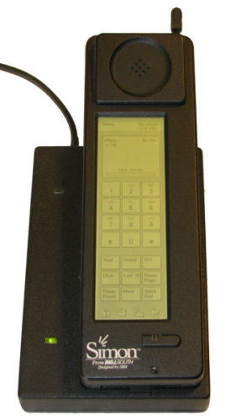
History of Development
Touchscreen
  Eric Johnson, of the Royal Radar Establishment, England, explained capacitive touchscreens in 1965
  First touchscreen phone is IBM Simon Personal Communicator (1992)

Slide 8
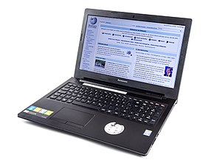
History of Development
Laptop (end of 1990)
  Small, portable personal computer

Slide 9
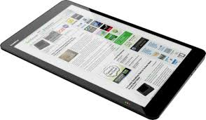
History of Development
Tablet computer (1990)
  Commonly shortened to tablet, is a mobile device, typically with a mobile operating system and LCD touchscreen display processing circuitry, and a rechargeable battery

Slide 10
History of Development
Smartphone
  Multi-purpose handheld computing and communication devices.
    IBM Simon Personal Communicator (1992)

Slide 11
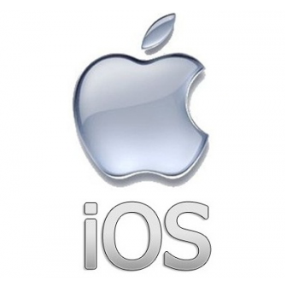
Development
iOS
  (formerly iPhone OS) is a mobile operating system created and developed by Apple Inc.
  Originally unveiled in 2007 for the iPhone,

Slide 12
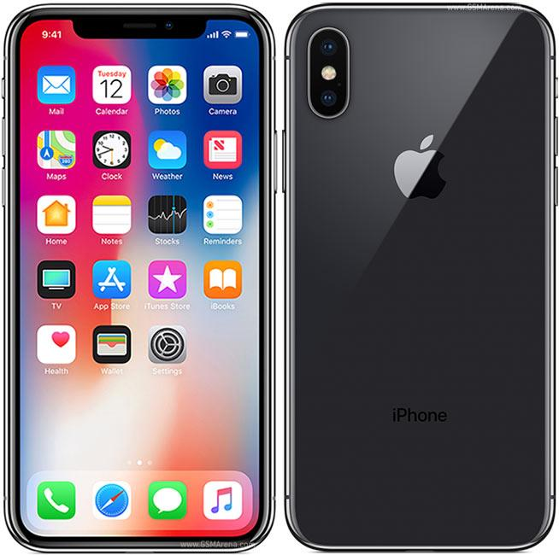
Development
iPhone (2007)
  Smartphone model designed and marketed by Apple Inc.

Slide 13

History of Development
Android Operating System
  Unveiled in 2007
  First commercial Android device launched in September 2008

Slide 14
Principles
Portability:
  Devices connected within the mobile computing system should facilitate mobility
Connectivity
  Ability to continuously stay connected with others
Social Interactivity
  Collaborate with other users
Individuality
  Adapting the technology to suit individual needs

Slide 15
Limitations
Range and bandwidth
  Slower than cable
Security
  Vulnerable to unknown access
Power consumption
  Must rely entirely on battery power
Potential health hazards
  Traffic hazards , Affect of radiation

Slide 16
Advantages
Location Flexibility
  Enabled users to work from anywhere
Saves Time
  Time wasted while travelling from different locations or to the office and back
Enhanced Productivity
  Users can work efficiently and effectively from whichever location they find comfortable.

Slide 17
Advantages
Entertainment
  Video and audio recordings can now be streamed wherever using mobile computing.
Streamlining of Business Processes
  Business functions can be run over secure links and sharing of information between business partners can also take place
  Meetings, seminars and other informative services can be conducted using video and voice conferencing.

Slide 18
Immerging Trends
Mobile Commerce
Mobile Banking
Mobile Wallet
  A type of payment service through which businesses and individuals can receive and send money via mobile devices

Slide 19
Immerging Trends
GPS tracking
  Locating a location or moving entity

